Slide 1
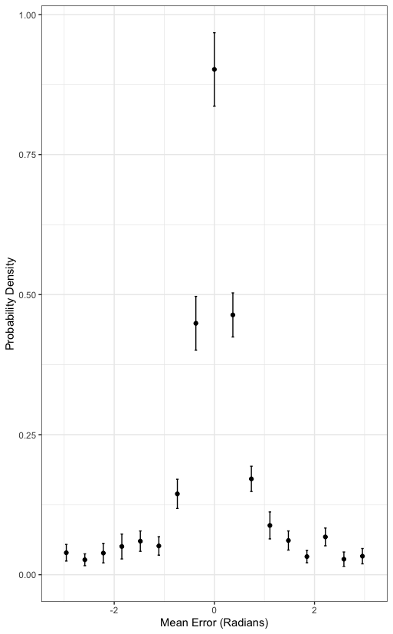
Encoding Phase
+
Retention Interval
R
T
Recall Phase
+

